Slide 1
Accident detection on roads and Pedestrian using CNN and VideoBERT
Advanced Software Engineering Proposal
By
Lakshmi Keerthi Ayyagari
(z1901169)

Slide 2
Main Objective/Aim of this study
The aim of the study is to detect the number of accidents by using Image of CCTV footage.
The objective is to understand that which CNN model is the best prediction model for prediction of accidents.
The VideoBERT method will be utilized for video classification, which will determine whether accidents will occur by utilizing videos of CCTV footage.
The few questions which I am trying to answer in this study are whether the cause of accidents is due to weather conditions or if the driver is accountable for producing accidents.
Identifying accidents that occurred as a result of a driver or a pedestrian on the road are some of the questions to be analyzed.

Slide 3
Accident detection on roads and Pedestrian using CCTV video
The dataset which I am going to use here is a YouTube video compilation of accidents.
Attaching the link here as well:
Indian Road accidents compilation 2021 – YouTube
https://www.youtube.com/watch?v=IR-zaDCC-iM

Slide 4
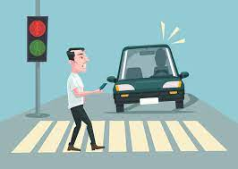
Introduction
Accidents involving pedestrians are uncommon occurrences that occur when drivers violate traffic laws; nevertheless, there may be other reasons for road accidents.
The CCTV footage in this video was acquired from a YouTube accident compilation film which includes road accidents as well as Pedestrian.

Slide 5
Methodology
Convolutional Neural network
VideoBERT Classifier
Evaluation Metrics

Slide 6
Steps
Convert Video data to Images by defining generator; Generator basically provides the images of videos and then we will use CNN method to Analyze the images.
Images will capture the activity and we will train the images by using Convolutional model with some important parameters.
CNN basically works with weights, For calculation of the weights, optimizers will use. Optimizers used to reduce the loss function. To understand or to study the trained data deeply we use Epochs, epochs trains the whole training data,In one epochs how many iteration is required that we decide by the Total number of the data (Size of the data) divided by the batch size.

Slide 7
Steps Cont.…
To Analyze the images, we will train the images by using specific optimizers, batch sizes, loss function (MSE), metrics, number of iteration, number of epochs.
VideoBERT does the same but with different algorithm. It is a self-supervised system that is able to perform actions from the unlabeled video.

Slide 8
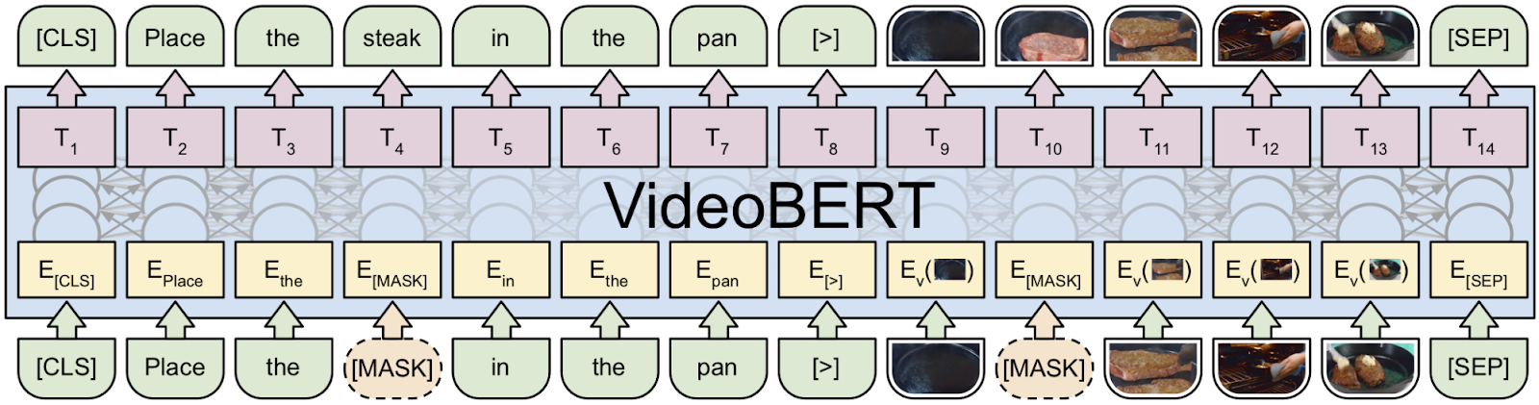
VideoBERT Model

Slide 9
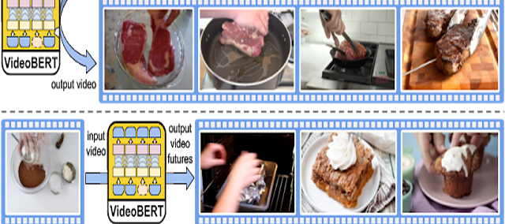
Model

Slide 10
Python
For doing this assignment the below will be used:
Tensorflow/keras
Scikit Learn (For Evaluation Metrics)
Numpy (For mathematical computation)
Pandas ( for data manipulation)
Matplotlib and Seaborn (For visualization)
And some necessary libraries to complete the task

Slide 11
Evaluation Metrics
Evaluation Metrics evaluate the model and checks the performance of model on test data.
It provides the accuracy of model on test data.
For classification Method, Confusion Matrix and classification report is used to evaluate and check the performance of model.

Slide 12
References
P. Khorrami, T. Le Paine, K. Brady, C. Dagli and T. S. Huang, "How deep neural networks can improve emotion recognition on video data," 2016 IEEE International Conference on Image Processing (ICIP), 2016, pp. 619-623, doi: 10.1109/ICIP.2016.7532431.
Google's VideoBERT Can Predict What Happens next in Videos | Beebom
https://thisvideo.works/2019/11/bert-and-videobert-googles-latest-algorithm-and-predictive-video-search-2/
https://openaccess.thecvf.com/content_ICCV_2019/papers/Sun_VideoBERT_A_Joint_Model_for_Video_and_Language_Representation_Learning_ICCV_2019_paper.pdf

